Slide 1

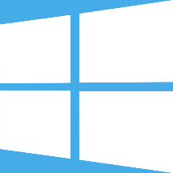

Microsoft Azure Iot Hub Lab
Slides: https://goo.gl/Pg7nRp
By Raffaele Aldrigo

Slide 2
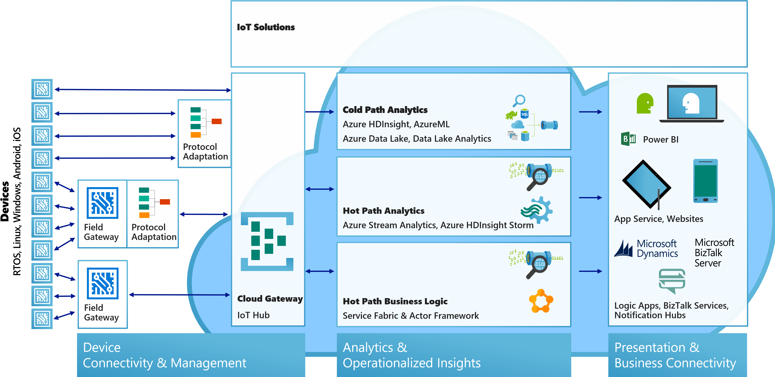
Iot on Azure

Slide 3
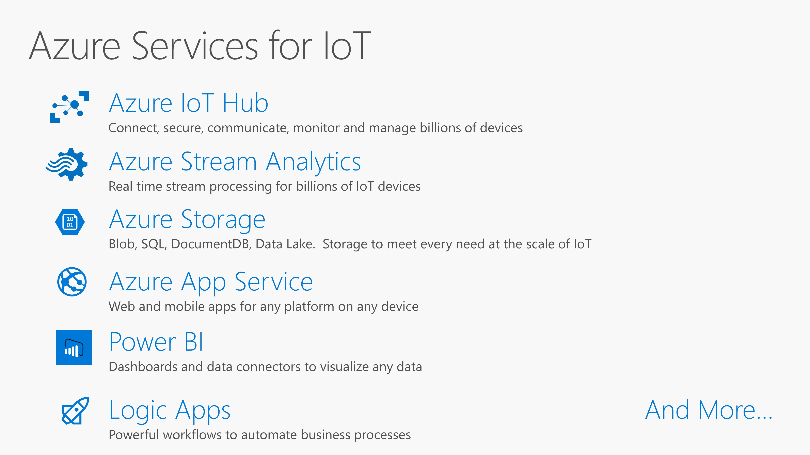

Slide 4
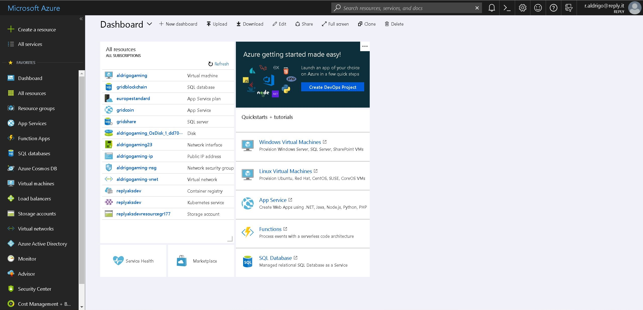
Where is azure

Slide 5
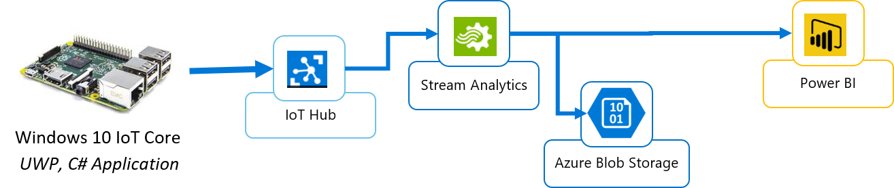
Sample Iot app
We want to get sensor datas from a device
Send data on the «cloud» -> Azure Iot Hub
Extract data from Azure Iot Hub
Analyze data (Power BI)

Slide 6
What is Azure Iot Hub?
It is a SaaS that allows to:
Authorize, identify and connect devices
Collect telemetry from devices (Device 2 Cloud)
Send Cloud 2 Device messages
Send commands to devices (Device Method)
Reports devices informations thanks to TwinDevice

Slide 7
IOT HUB ENDPOINTS
IoT Hub
Device
Device id
D2C receive endpoint
Event processing
(hot and cold path)
D2C send endpoint
C2D queue
endpoint
Device management, device business logic,
Connectivity monitoring
Twin endpoint
C2D send endpoint
Methods
endpoint
Msg feedback and monitoring endpoint
Field GW /
Cloud GW
Device …
Twins endpoint
Device…
Devices Methods endpoint
Device …
Device provisioning and authorization
Device identity management
IoT Hub management

Slide 8
Comprension question
What is the difference between a Cloud 2 Device message and a calling a Device Method?
1) Device Method requires the device to be online
2) Device Method it is direct to a specified device, executed (almost) immediatly
3) Cloud 2 device messages are received by all devices!

Slide 9
Device application
To acess Iot Hub functions we need a key. On the Iot Hub we can define various policies, and we will have one key for each policy.
How to: https://goo.gl/Uz3HEb
deviceClient = DeviceClient.Create(iotHubUri, new DeviceAuthenticationWithRegistrySymmetricKey(deviceId, deviceKey), TransportType.Mqtt);
//update twin
var twin = await deviceClient.GetTwinAsync();
var reportedProperties = new TwinCollection();
reportedProperties["key"] = ...;
await deviceClient.UpdateReportedPropertiesAsync(reportedProperties);
await deviceClient.SetMethodHandlerAsync("deviceMethod", DeviceMethod, null);
Task.WaitAll( SendDeviceToCloudMessagesAsync(), ReceiveC2dAsync() );

Slide 10
private static async Task SendDeviceToCloudMessagesAsync() {
while (true) {
var telemetryDataPoint = ...
var message = new Message(Encoding.ASCII.GetBytes(JsonConvert.SerializeObject(telemetryDataPoint)));
await deviceClient.SendEventAsync(message);
await Task.Delay(3000);
}
}
private static async Task ReceiveC2dAsync() {
while (true) {
Message receivedMessage = await deviceClient.ReceiveAsync();
if (receivedMessage == null) continue;
string content = Encoding.ASCII.GetString(receivedMessage.GetBytes());
...
await deviceClient.CompleteAsync(receivedMessage);
}
}
public static Task<MethodResponse> DeviceMethod(MethodRequest methodRequest, object userContext) {
...
}

Slide 11
What will you do in this lab?
Listen Device 2 Cloud messages
Send Cloud 2 Device messages
Read device reported properties using twin device
Call device method (direct method)
Notes:
Mettere come prima slides in prosa degli obiettivi e poi slides di agenda

Slide 12
Requirements:
Visual Studio (or Visual Studio Code) with C# console application
Let’s subdivide in teams (max 20)
Download common library: https://goo.gl/oHTLcv
Create a new c# solution with a console app and reference IotLab.Common
Install NuGet Microsoft.Azure.Devices
For Visual Studio Code: https://goo.gl/jtYWnY

Slide 13
On your marks
Get set
Code!

Slide 14
1) Listen Device 2 Cloud messages
https://goo.gl/4QsYpF
eventHubClient = EventHubClient.CreateFromConnectionString(Config.IotHub.ConnectionStringService, "messages/events");
...
var partitions = eventHubClient.GetRuntimeInformation().PartitionIds;
foreach (string partition in partitions) {
ReceiveMessagesFromDeviceAsync(partition, cts.Token));
}
...
private static async Task ReceiveMessagesFromDeviceAsync(string partition) {
var eventHubReceiver = eventHubClient.GetConsumerGroup("teamXX").CreateReceiver(partition, DateTime.UtcNow);
while (true) {
EventData eventData = await eventHubReceiver.ReceiveAsync();
...
}
}

Slide 15
2) Send Cloud 2 Device messages
Guide: https://goo.gl/eucTrp
3) Read device twin reported properties
Guide: https://goo.gl/rqjLTv
4) Invoke direct method
var methodInvocation = new CloudToDeviceMethod("shutdown");
methodInvocation.SetPayloadJson(...);
serviceClient.InvokeDeviceMethodAsync(...);

Slide 16

Q&A
By Aldrigo Raffaele 2018

